Slide 1

Workshop Utilization of Satellite and Gridded Socioeconomic Data
BK Sparse FEB UGM
Introduction to R and Its Application on Spatial Analysis
Gigih Fitrianto

Slide 2

OUTLINES
Introduction: Regional Data & Thematic Maps (Lattice & Non-lattice) R and RStudio Installation Guidelines Basic Operation and For-Loops Vectors, Matrices, and Data Frames

Slide 3
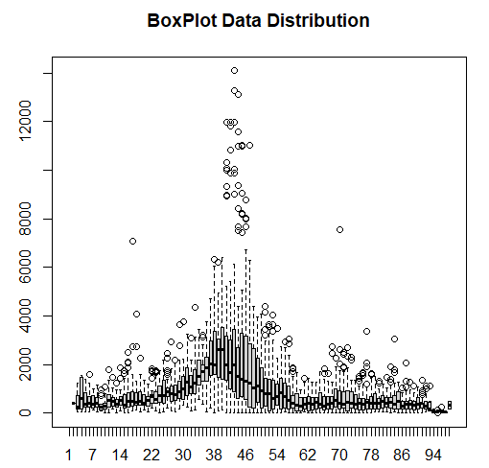
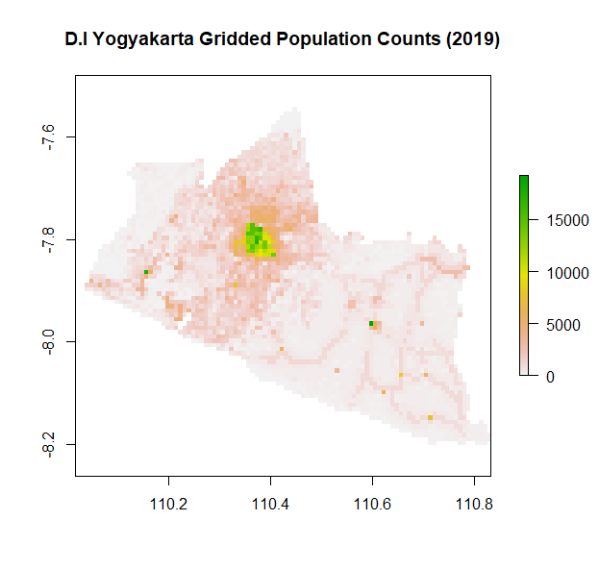
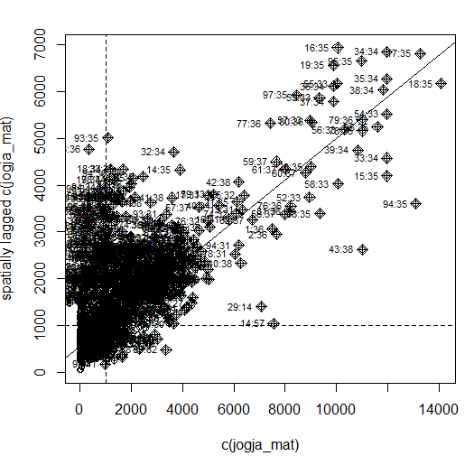
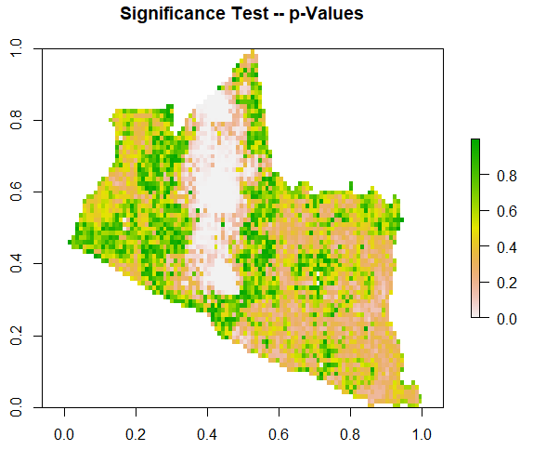
INTRODUCTION
UTILIZATION OF GRIDDED DATA
Descriptive
Spatial Analysis
Exploratory
Spatial Data
Spatial Detection Test
Spatial Econometric Analysis

Slide 4
INTRODUCTION
UTILIZATION OF GRIDDED DATA
Descriptive
Spatial Analysis
Exploratory
Spatial Data
Spatial Detection Test
Spatial Econometric Analysis
Mapping Overlay
Ms Excel
R
Stata
Matlab
GeoDA
ArcGIS
QGIS
Thematic Maps and Pattern Detection
Global Spatial
Moran’s I
Geary’s C
Local Spatial
Local Moran’s I
Local Geary’s C
Cluster Analysis
Non-Dynamic
SAR, SEM, etc
Dynamic
Spatio-temporal
Time Series
Bayesian vs VS (ML)

Slide 5
INTRODUCTION
UTILIZATION OF GRIDDED DATA
Descriptive
Spatial Analysis
Exploratory
Spatial Data
Spatial Detection Test
Spatial Econometric Analysis
raster
sf
sp
terra
spdep
maptools
rgal
ggplot2
tmap
lattice
terra
spdep
spatialreg
sphet
splm
spBayes
optim
optimx

Slide 6
INTRODUCTION
Analisis Ekonomi Regional
Keterikatan Wilayah
Spillover Effect/Convergences

Slide 7
INTRODUCTION
Analisis Ekonomi Regional
Keterikatan Wilayah
Spillover Effect/Convergences

Slide 8
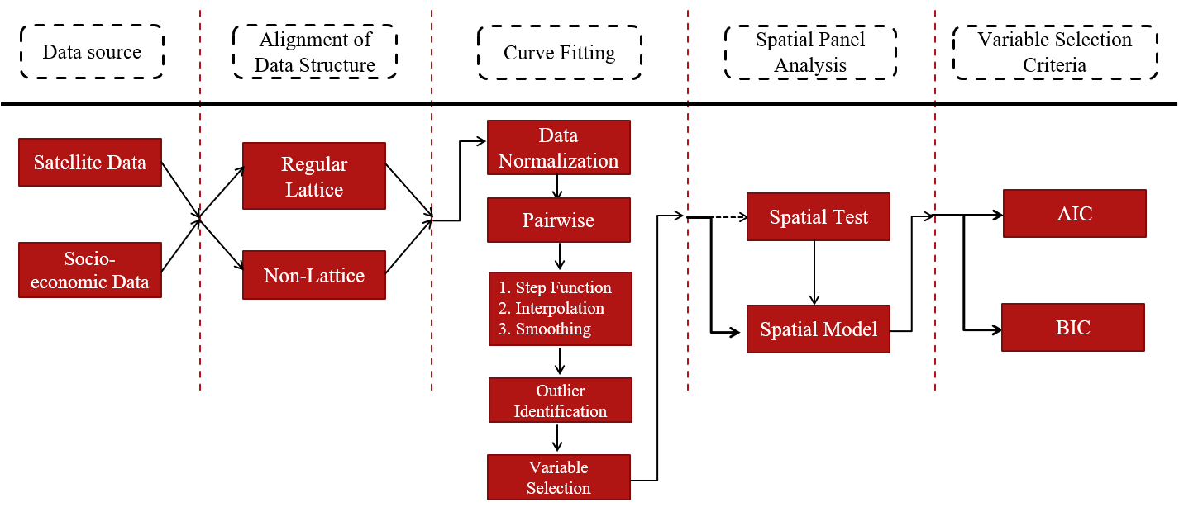
Generic Methodology for Data Incorporation
There are two data structure: Regular Lattice and Non-lattice. Regular Lattice = Grid-cell dataset and Non-Lattice = dataset represents each municipal body.

Slide 9
Introduction
Command-line software
requires knowledge of syntax of commands
reproducible results through scripts
detailed analyses possible
GUI-based software
does not require knowledge of commands
not reproducible actions
Hybrid types (both command-line and GUI)

Slide 10
Introduction
SAS
SPSS
Eviews
R
Python
MATLAB
GeoDa (Specialized for Spatial Analysis)
…

Slide 11
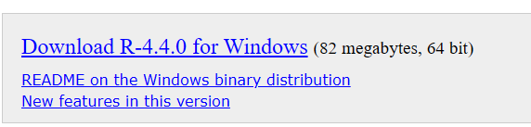
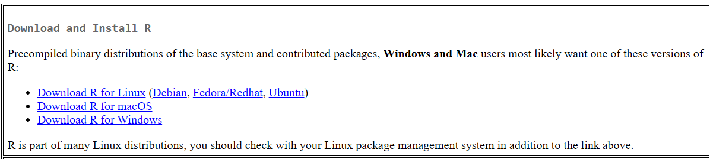
R and RStudio
Download R: Available on (Windows, Linux, Mac) https://cran.r-project.org/bin/windows/base/
Latest version: 4.4.0 You may also download the previous version.

Slide 12
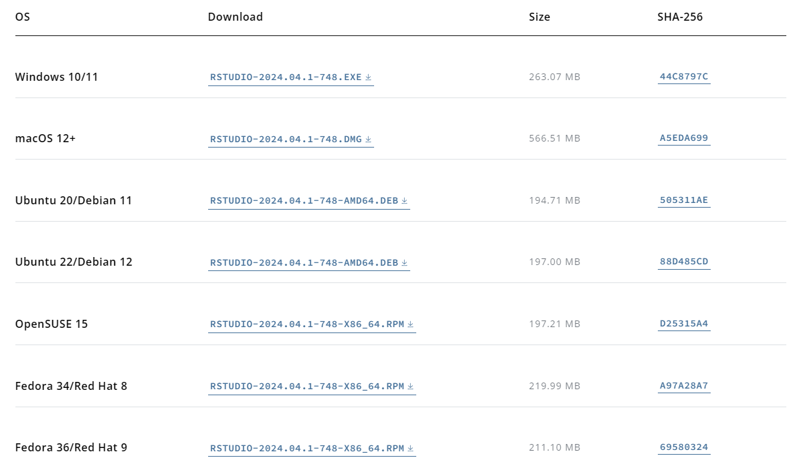
R and RStudio
Download for RStudio: Available on (Windows, Linux, Mac) https://posit.co/download/rstudio-desktop/
Latest version: 2024.04.1+748 You may also download the previous version.
Size: 263.07 MB

Slide 13
R and RStudio
Why use R?
It’s Freeware with Large and Updated Communities.
Powerful tools, especially for statistical and mathematical problems (e.g. Optimization, Grid Search, 3D Visualization, Raster and Spatial Object).
It has state-of-the-art graphics capabilities.
Even though Python emerged as a more popular free tool that provides a broader scope of analysis, especially for data science and beyond statistics, R still has a strong backbone for statistical analysis. Nowadays we combine both for the analysis.
Better to learn both!

Slide 14
R and RStudio
List of Tutorials
P. Kuhnert & B. Venables, An Introduction to R: Software for Statistical Modeling & Computing
J.H. Maindonald, Using R for Data Analysis and Graphics
Florian Heiss, Using R, Python and Julia for Introductory Econometrics https://www.urfie.net/
W.J. Owen, The R Guide
D. Rossiter, Introduction to the R Project for Statistical Computing for Use at the ITC
W.N. Venebles & D. M. Smith, An Introduction to R

Slide 15
R and RStudio
List of Tutorials
Paul Geissler's excellent R tutorial
Dave Robert's Excellent Labs on Ecological Analysis
R time series tutorial
R Concepts and Data Types
Interpreting Output From lm()
The R Wiki
An Introduction to R
Import / Export Manual
R Reference Cards

Slide 16
R and RStudio
Most functionality is provided through built-in and user-created functions and all data objects are kept in memory during an interactive session.
Basic functions are available by default. Other functions are contained in packages that can be attached to a current session as needed. (e.g. mean, sd, sum, rowSums, matrix, lm)
Additional functions are coming from the communities and can be searched and installed within or manually copy-paste into the directory. (e.g. raster, trace, sparse.matrix, crop, mask, 3Dplot)

Slide 17
R and RStudio
For newcomers and those not familiar with the coding environment, R basic (the original apps) may be quite challenging.
Therefore, in this workshop we will use RStudio that provides better user interface, interactive environments, easier for editing and writing the R codes.

Slide 18
R and RStudio
R Interface and Environments
Launch R or RStudio (you need to choose one of those options).
We choose RStudio later that consists of ‘Console’ window as the main area for writing some R commands and scripts.

Slide 19
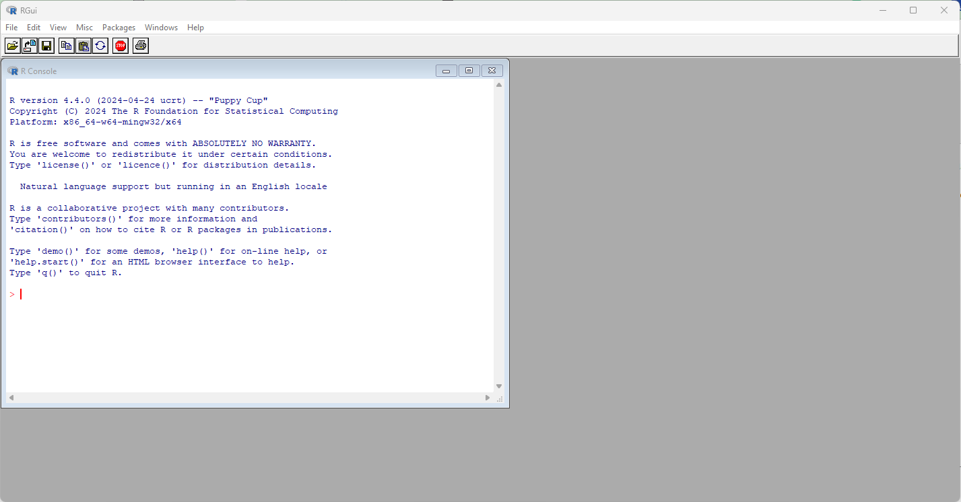
R Environment

Slide 20
R and RStudio
R Interface and Environments
Launch R or RStudio (you need to choose one of those options).
We choose RStudio later that consists of ‘Console’ window as the main area for writing some R commands and scripts.

Slide 21
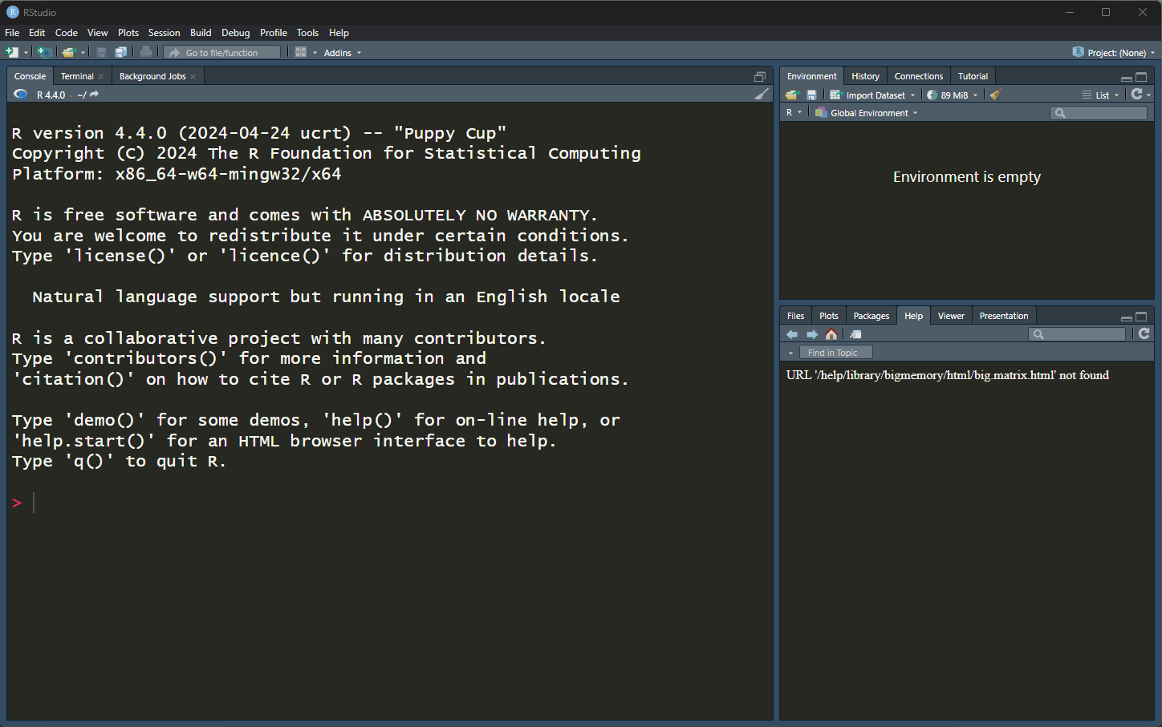
RStudio Environment

Slide 22
Object Storage
Windows or Visualization Area
RCode Console and Terminal

Slide 23
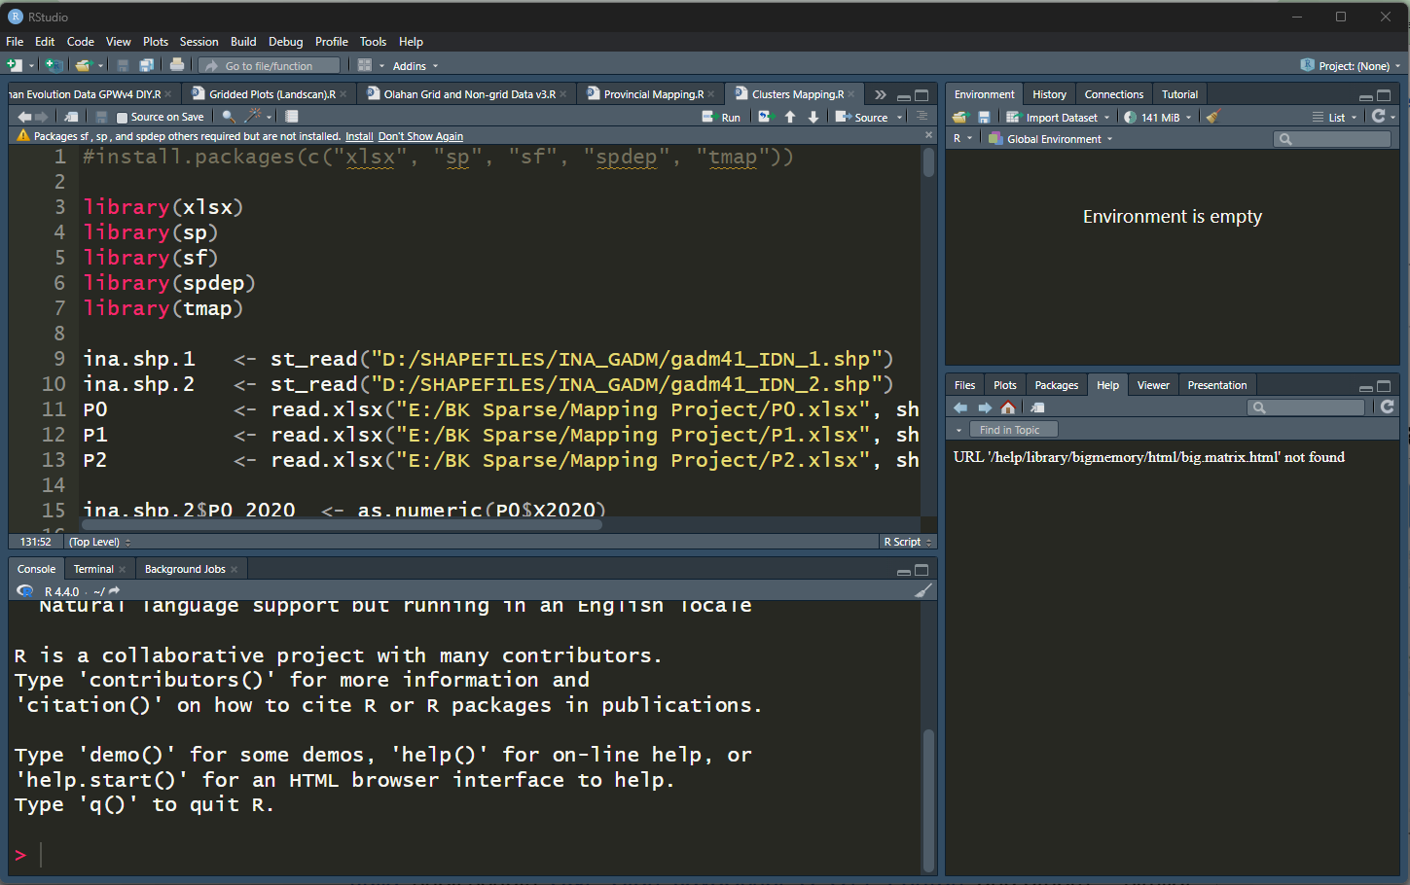
Object Storage
RCode Writing/Editing Area
Windows or Visualization Area

Slide 24
Object Storage
libraries
Windows or Visualization Area

Slide 25
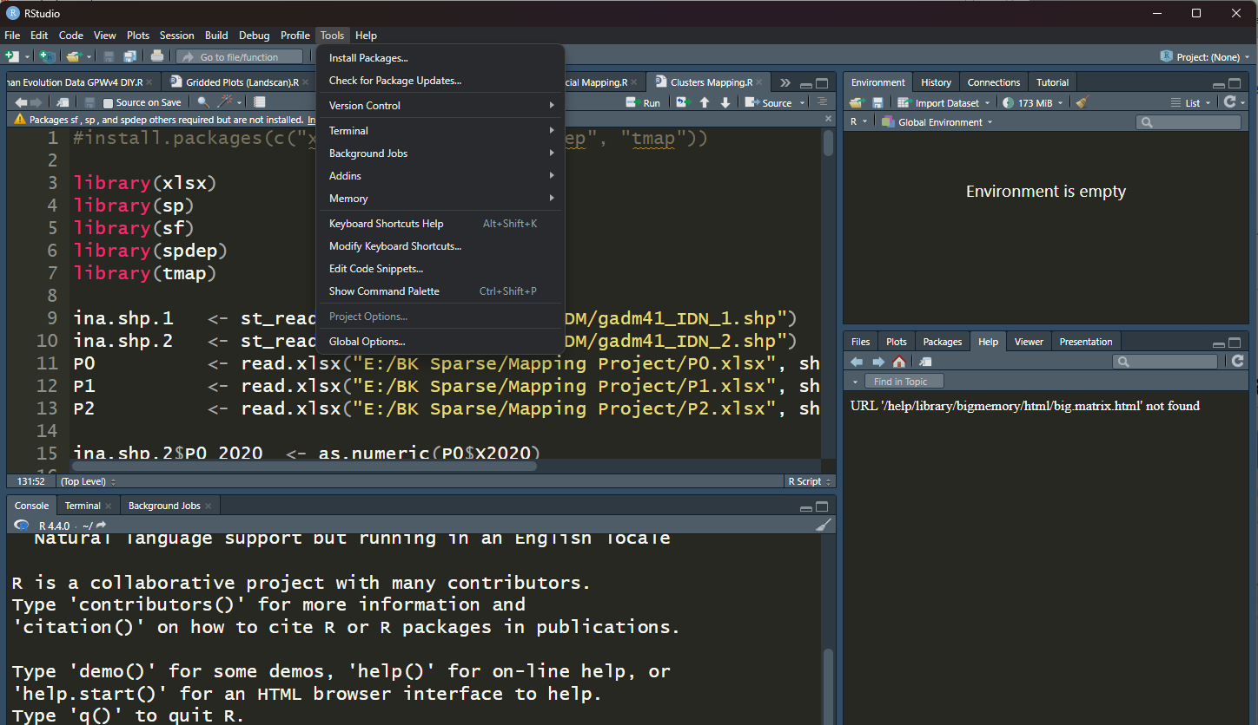
Object Storage
libraries
Windows or Visualization Area

Slide 26
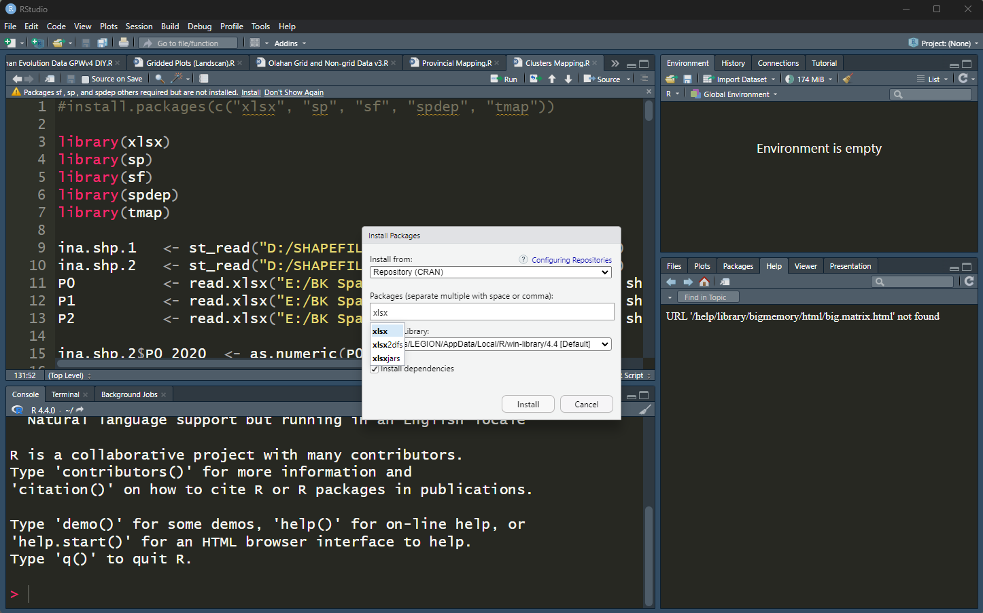
Object Storage
libraries
Windows or Visualization Area

Slide 27
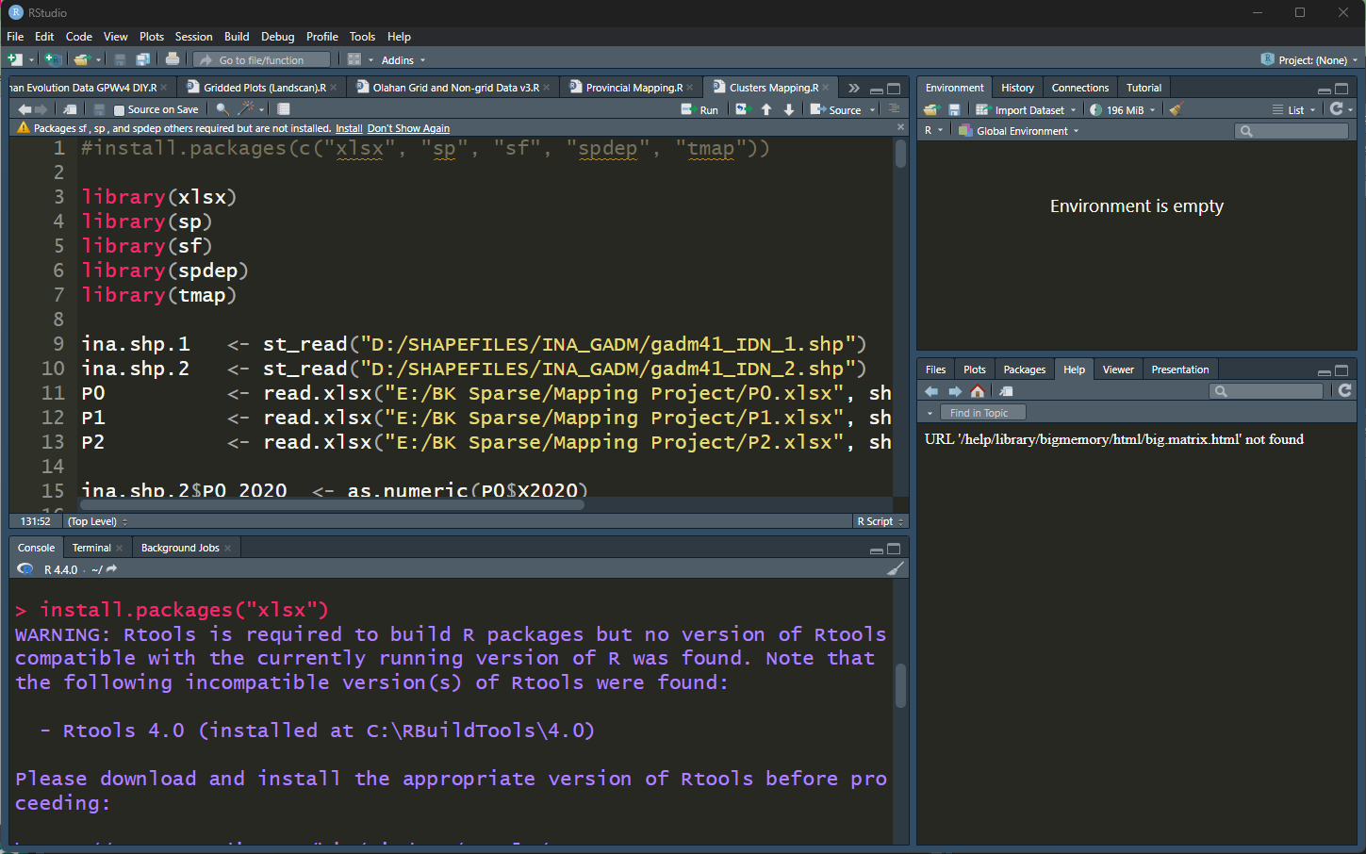
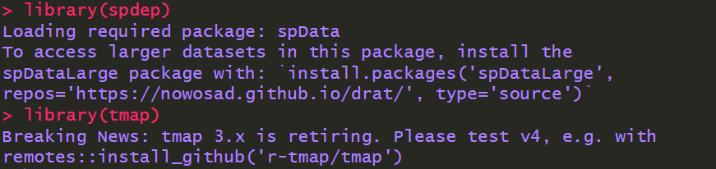
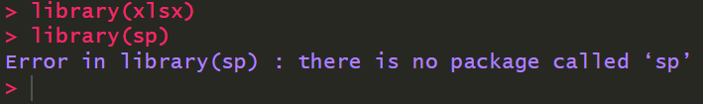
Object Storage
libraries
Windows or Visualization Area

Slide 28
R and RStudio
R Introduction and Basic Functions
Results of calculation can be stored in objects using the arrow operator (<-) and single equal sign (=) (be careful! A single equal sign ‘=’ used for storing or define any object, in R to use equal form in mathematics we need to use double equal sign, ‘==’)

Slide 29
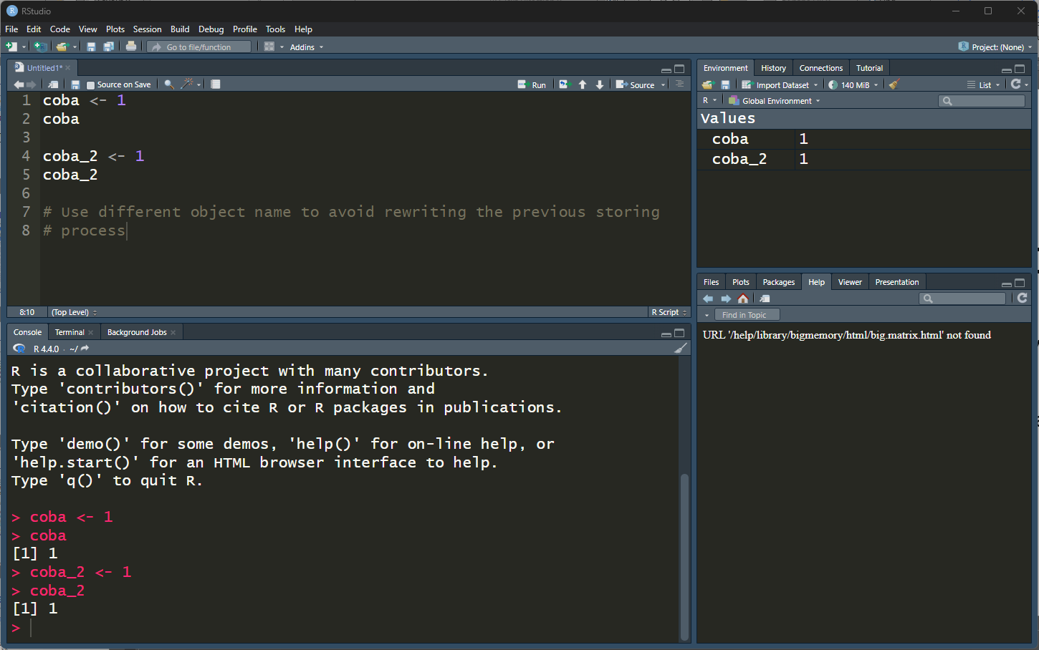
R and RStudio

Slide 30
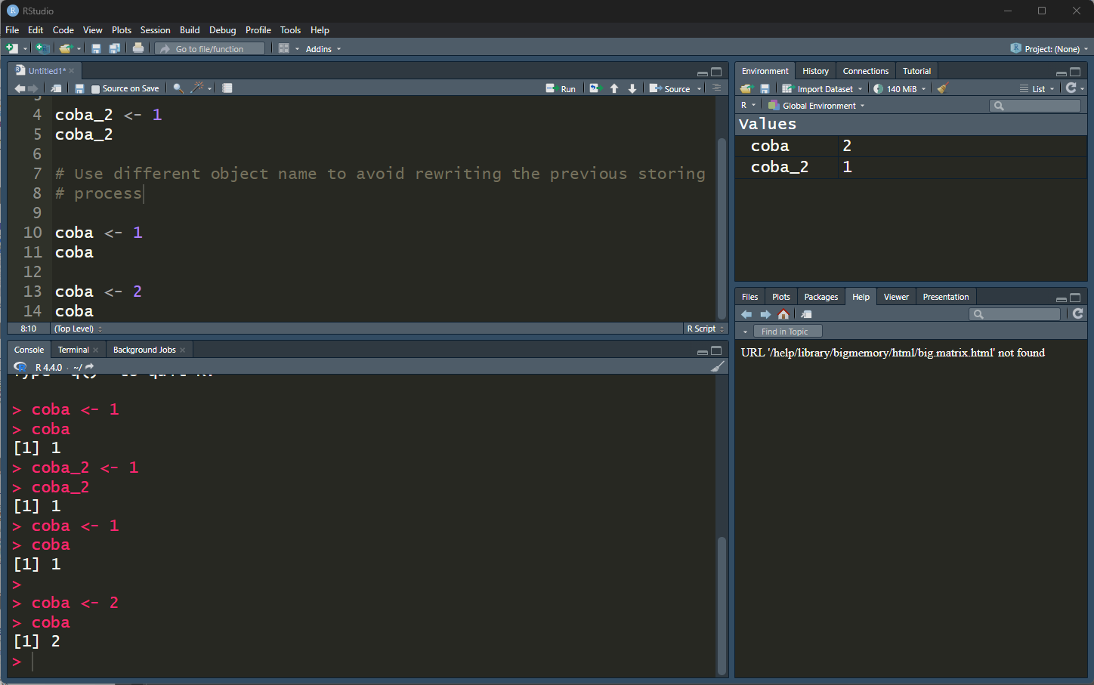
Object ‘coba’ has different values after defining coba <- 2
Better used coba_2 <- 2
Therefore there are 2 different objects

Slide 31
R and RStudio
R Introduction and Basic Functions
Basic operators: +, -, =, /, *
Assignment operation: a <- 2+sqrt(5)
Help function:
help(pnorm)
help.search(“normal distribution”)

Slide 32
R and RStudio
R Introduction and Basic Functions
Installing necessary libraries
install.packages(“Matrix”)
install.packages(c(“Matrix”, “dplyr”, “matrixcalc”))
Load the packages
library(“Matrix”)
library(“matrixcalc”)

Slide 33
Data Creation
create
vectors: c(1,2,3)
matrices: matrix(c(1,2,3,4,5,6),2,3,byrow=T) (2=#rows),
arrays(values, dim=c( )): create higher dimension matrix, with n more than 2.
data.frame
patterns:
“:” (1,2,3) = 1:3
seq (1,2,3) = seq(1,3,by=1)
rep(1,3): create repeated value of 1 by 3 times
working directories and files:
setwd
getwd
attach
read data
from file: read.table(“file.txt”,header=TRUE); read.xlsx(“file.xlsx”, sheetName = “”)
from web: read.data.url

Slide 34
Data Creation
d[r,]: rth row of object d
d[,c]: cth column of object d
d[r,c]: entry in row r and column c of object d
length(d): length of d (specific for vector object)
dim(d): matrix dimensions of matrix d
d[d<20]: extract all elements of d that are smaller than 20
d[“age”]: extract column “age” from object d
which( ) : function to look for element with specific attributes
Example: D <- matrix(seq(1,4,1), ncol=2, nrow=2)
D[1,1]
> 1

Slide 35
Data Plot
plot: both 1D and 2D plots
For 3d plot you can use rgl, scatterplot3d, plotly, lattice libraries
hist: histogram
Raster library use for mapping spatial
Save graphics by choosing File -> Save as
Or, you can use specific function
png( )
dev.off( )

Slide 36
Basic Statistics
summary
mean
median
stdev
cor
t.test

Slide 37
Basic Function
Analyses that have to be performed often can be put in the form of functions
Example: simple <- function(data,mean=0,alpha=0.05)
{hist(data),t.test(data,conf.level=alpha,mu=mean,alternative=“two-sided”)}

Slide 38
Basic Regression
general command: lm (linear model)
requires data to be available in the form of a data frame
more general than matrix because columns need not have same length)
use command data.frame for conversion
other types of regression also possible (see also dedicated packages)

Slide 39
OUTLINES II
R for Spatial Analysis: Common Libraries Crop and Mask Process Data Extraction Local and Global Spatial Autocorrelation Spatial Econometrics

Slide 40
Basic Function
Common Libraries for Spatial Analysis:
• SP “spatial”
• GSTAT “geostatistics”
• RGDAL “geospatial data abstraction library for R” (not active since end of 2023)
• TERRA “Spatial Data Analysis”
• GGMAP “extends the plotting of ggplot2 with map data”
• RASTER “raster data processing”
• MAPTOOLS “map tools”
• SPATSTAT “wide range of spatial tools and functions”

Slide 41
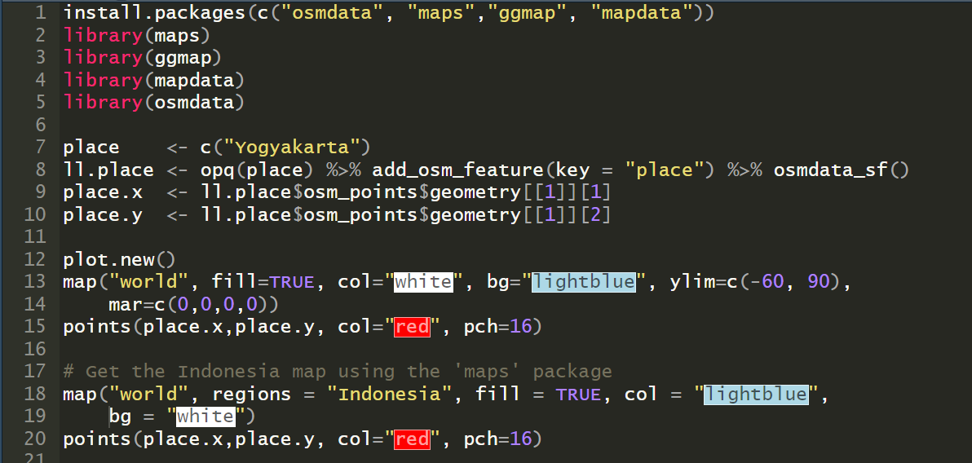
Basic Function
Example:

Slide 42
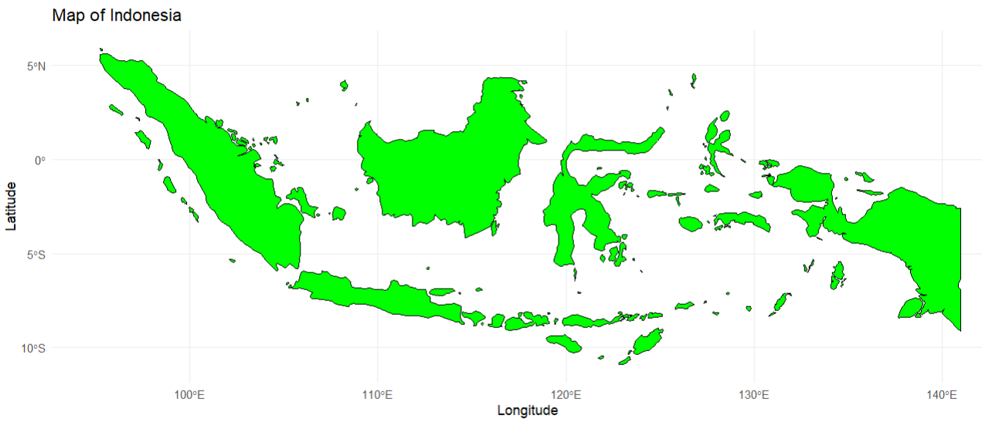
Basic Function
Example:

Slide 43
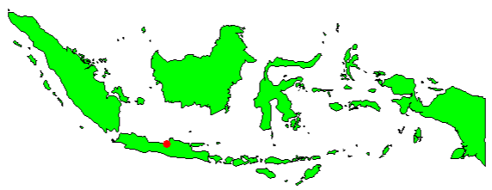
Basic Function
Example:

Slide 44
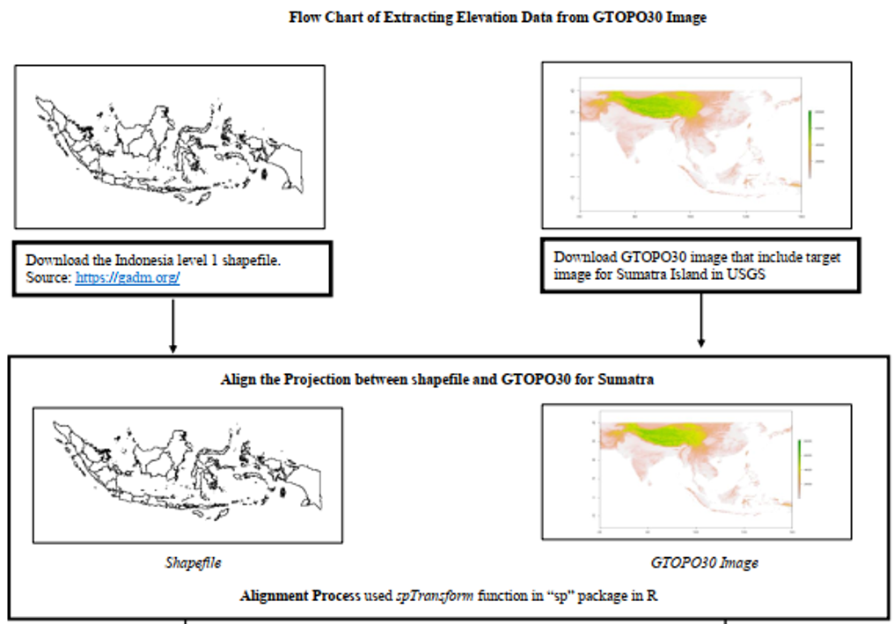
Generic Methodology for Data Incorporation

Slide 45
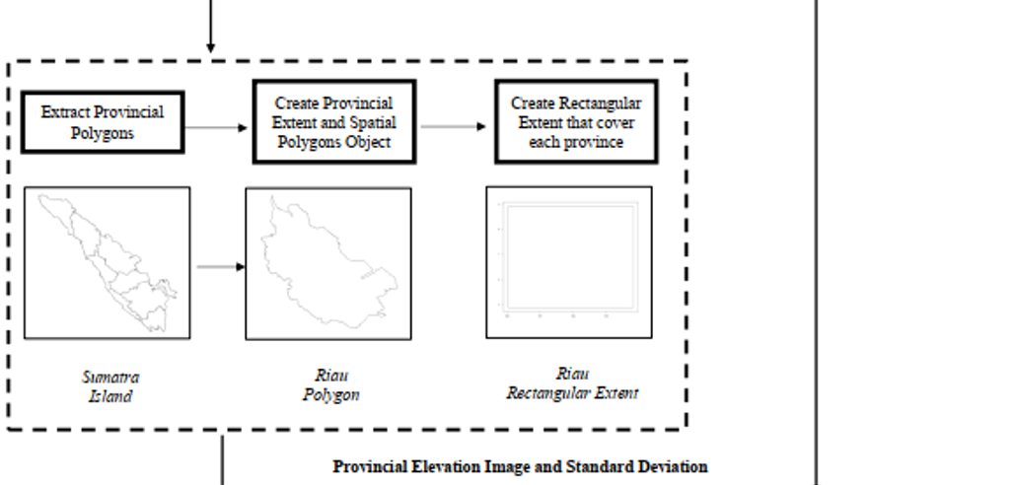
Generic Methodology for Data Incorporation

Slide 46
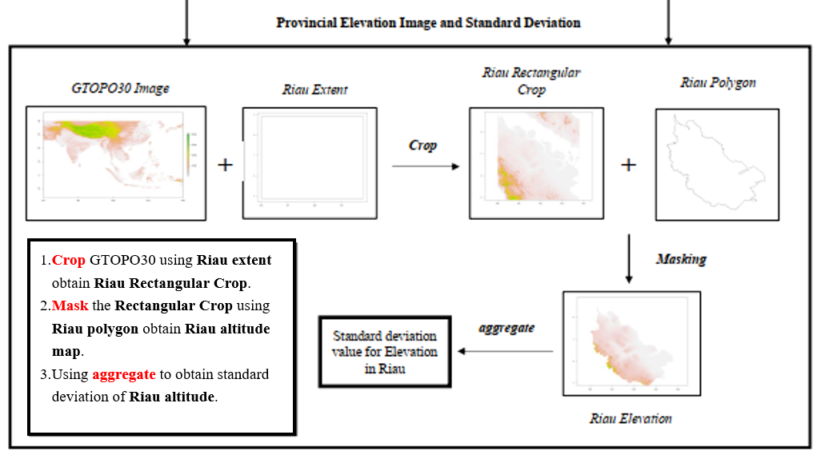
Generic Methodology for Data Incorporation

Slide 47
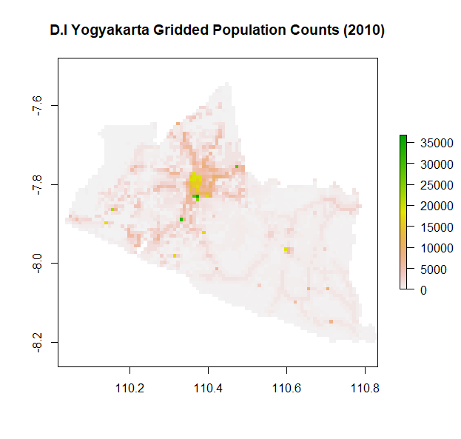
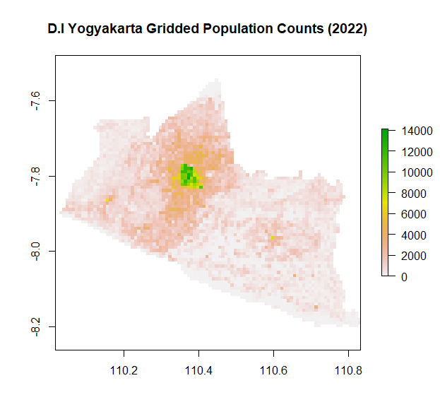
DATA EKONOMIKA SPASIAL: Population Distribution
LATTICE (Grid-cell Data)
Examples: Population Counts and Population Distribution for Jogjakarta, Indonesia.

Slide 48
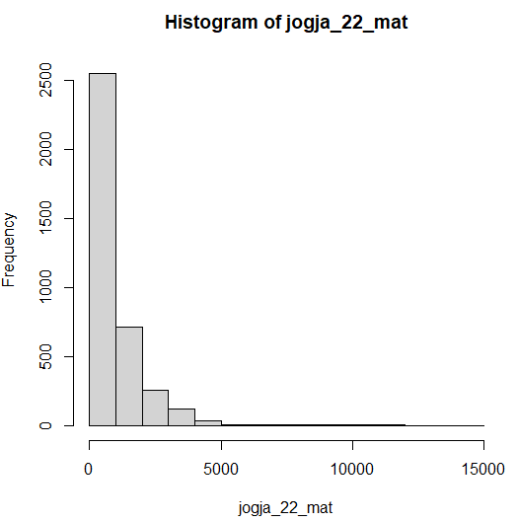
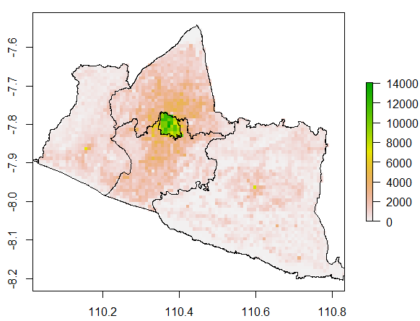
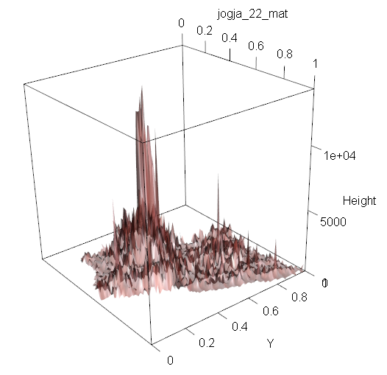
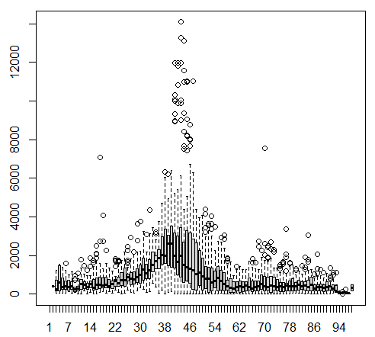
Analisis Wilayah DI Yogyakarta: Pop Distribution
DI Yogyakarta Population Distribution 2022
LandScan Gridded Data
Spatial Dimension: 30 x 30 arc second (~ 1 km)
Source: Oak Ridge National Laboratory

Slide 49
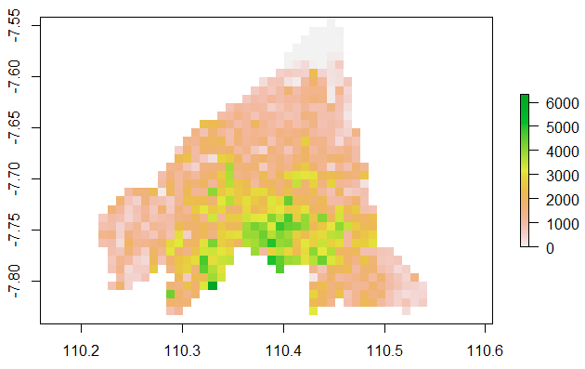
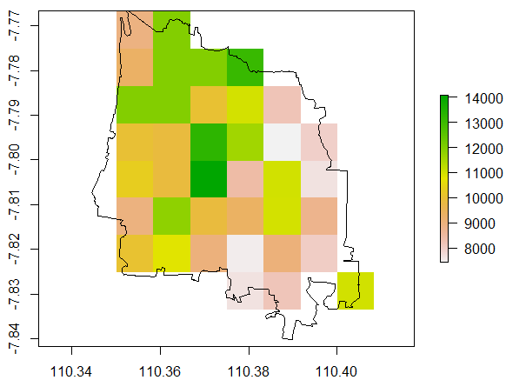
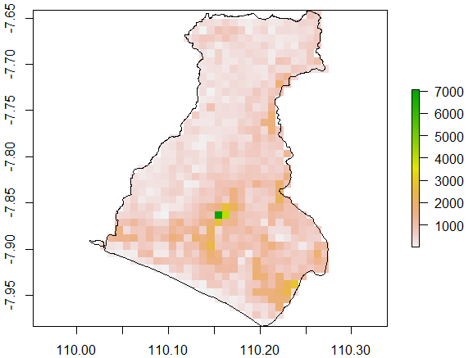
Analisis Wilayah DI Yogyakarta: Pop Distribution
DI Yogyakarta Population Distribution 2022
Datasize : 1440
Mean : 1704.317
St. Dev. : 1083.575
Sleman
Datasize : 72
Mean : 10090.87
St. Dev. : 1756.163
Kota Yogyakarta
Datasize : 1271
Mean : 548.6358
St. Dev. : 454.0585
LandScan Gridded Data
Spatial Dimension: 30 x 30 arc second (~ 1 km)
Source: Oak Ridge National Laboratory
Kulon Progo

Slide 50
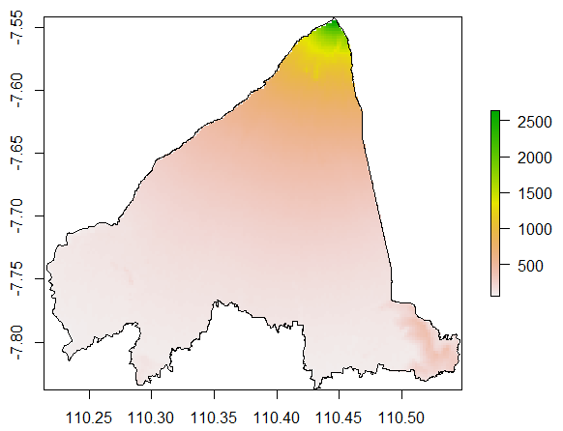
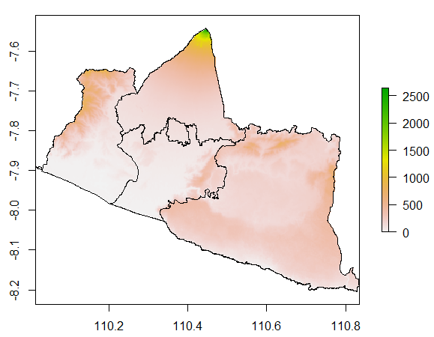
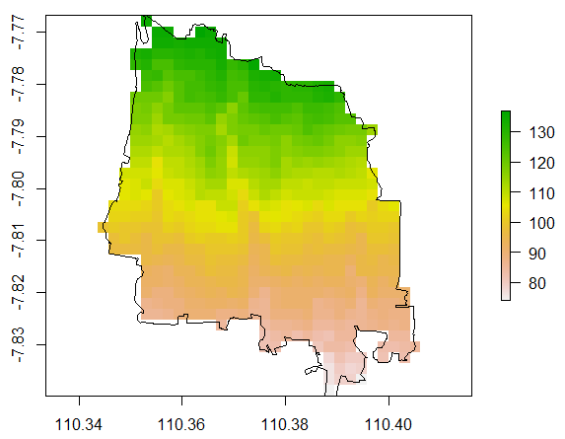
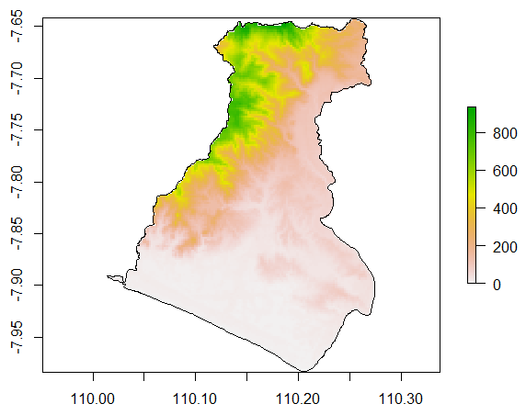
Analisis Wilayah DI Yogyakarta: Elevation
DI Yogyakarta Elevation
Datasize : 22436
Mean : 303.0695
St. Dev. : 283.4072
Sleman
Datasize : 1050
Mean : 105.6661
St. Dev. : 14.5037
Kota Yogyakarta
Datasize : 20500
Mean : 171.1791
St. Dev. : 200.8711
GMTED2010 Elevation Data
Spatial Dimension: 7.5 x 7.5 arc second (~ 225 m)
Source: USGS and National GeoSpatial-Intelligence Agency (NGA)
Kulon Progo

Slide 51
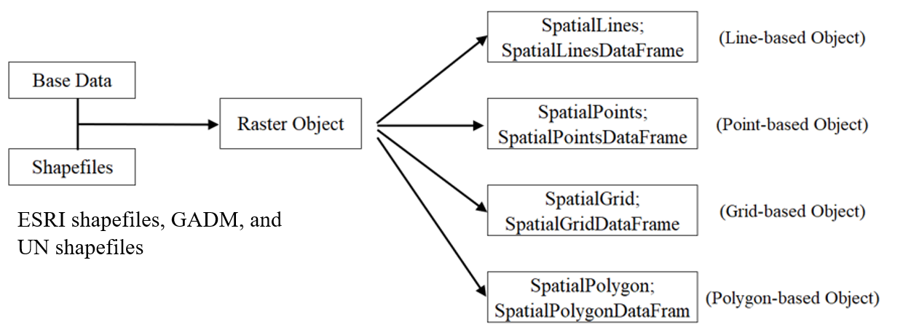
THE ROLE OF SPATIAL NEIGHBOR W MATRIX: Non-rectangular Shape
There exist missing value (NA) cells for non-inhabitant area (water bodies or desert area). The general process based on shapefile, which stores geometry and attribute information for the spatial features (ESRI, 1998) of the area as base information to construct W matrix is not suitable.
Note: *) The figure is a summarization based on Bivand, Pebesma, and Gómez-Rubio (2008), Arbia (2014), Dmowska and Stepinski (2017), and Baddeley, Turner, and Rubak (2018).
Figure. General Shapefile Handling Process for Spatial Analysis.*

Slide 52
Analisis Wilayah DI Yogyakarta: Pop Distribution
DI Yogyakarta Population Distribution 2022
Problems arise when we use the usual R package: spdep for Spatial Autocorrelation Test based on the Gridded Data.
The matrix extract the rectangular area created by the bbox based on the extent information embedded in the polygon of the interested area.
LandScan Gridded Data
Spatial Dimension: 30 x 30 arc second (~ 1 km)
Source: Oak Ridge National Laboratory

Slide 53
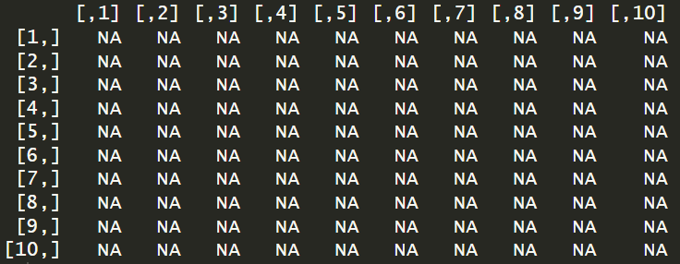

Analisis Wilayah DI Yogyakarta: Pop Distribution
DI Yogyakarta Population Distribution 2022
$10×10$ Area
Solutions?
LandScan Gridded Data
Spatial Dimension: 30 x 30 arc second (~ 1 km)
Source: Oak Ridge National Laboratory

Slide 54
Analisis Wilayah DI Yogyakarta: Pop Distribution
DI Yogyakarta Population Distribution 2022
Solutions:
Data Amputation + Data Replacement
Without the usage of package: Utilization of Kronecker Product to construct W matrix and Using Projection Matrix P (Fitrianto, Tanaka, Nishii, 2018)
LandScan Gridded Data
Spatial Dimension: 30 x 30 arc second (~ 1 km)
Source: Oak Ridge National Laboratory

Slide 55
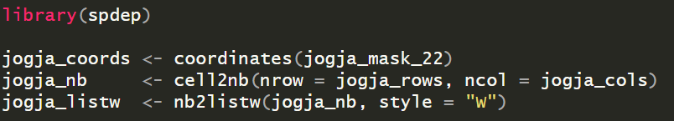
Analisis Wilayah DI Yogyakarta: Pop Distribution
DI Yogyakarta Population Distribution 2022
Solutions:
Data Amputation + Data Replacement
LandScan Gridded Data
Spatial Dimension: 30 x 30 arc second (~ 1 km)
Source: Oak Ridge National Laboratory

Slide 56
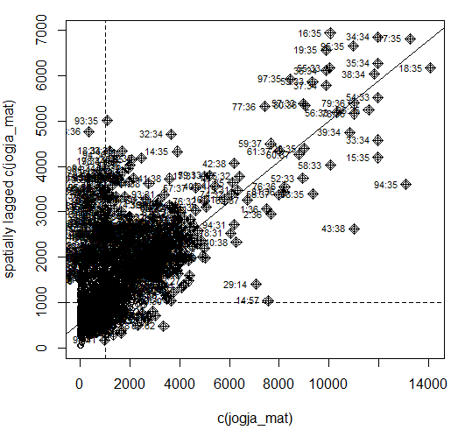
Analisis Wilayah DI Yogyakarta: Pop Distribution
DI Yogyakarta Population Distribution 2022
Solutions:
Data Amputation + Data Replacement
LandScan Gridded Data
Spatial Dimension: 30 x 30 arc second (~ 1 km)
Source: Oak Ridge National Laboratory

Slide 57
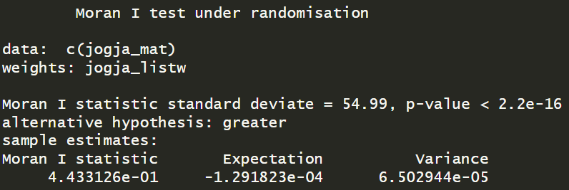
Analisis Wilayah DI Yogyakarta: Pop Distribution
DI Yogyakarta Population Distribution 2022
Solutions:
Data Amputation + Data Replacement
LandScan Gridded Data
Spatial Dimension: 30 x 30 arc second (~ 1 km)
Source: Oak Ridge National Laboratory

Slide 58
Analisis Wilayah DI Yogyakarta: Pop Distribution
DI Yogyakarta Population Distribution 2022
Solutions:
Without the usage of package: Utilization of Kronecker Product to construct W matrix and Using Projection Matrix P (Fitrianto, Tanaka, Nishii, 2018)
LandScan Gridded Data
Spatial Dimension: 30 x 30 arc second (~ 1 km)
Source: Oak Ridge National Laboratory

Slide 59
DI Yogyakarta Data Analysis: Spatial Econometric Analysis
Pure Spatial Autoregressive Model (PSAR)

Slide 60
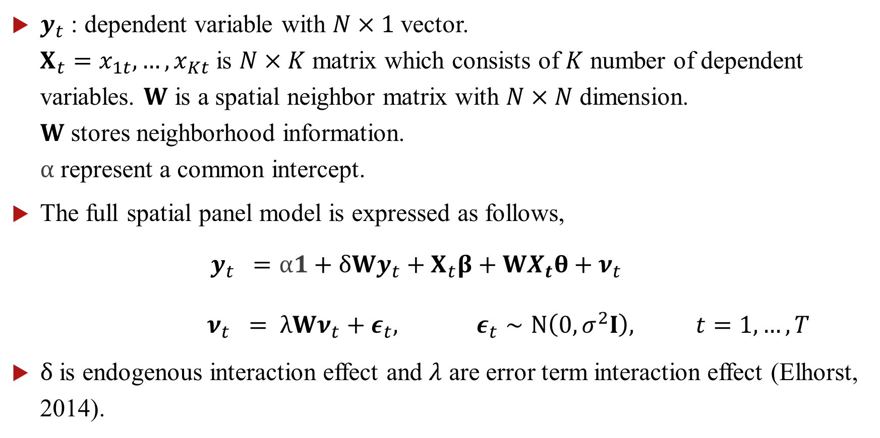
Spatial Configuration
$y_{t}$ : dependent variable with $N×1$ vector. $X_{t}=x_{1t},…, x_{Kt}$ is $N×K$ matrix which consists of $K$ number of dependent variables. $W$ is a spatial neighbor matrix with $N×N$ dimension. $W$ stores neighborhood information. $α$ represent a common intercept.
The full spatial panel model is expressed as follows,
$$y_{t} =α1+δWy_{t}+X_{t}β+WX_{t}θ+ν_{t}$$
$$ν_{t} = λWν_{t}+ε_{t}, ε_{t}∼N\left(0, σ^{2}I\right), t=1,…, T$$
$δ$ is endogenous interaction effect and $λ$ are error term interaction effect (Elhorst, 2014).

Slide 61
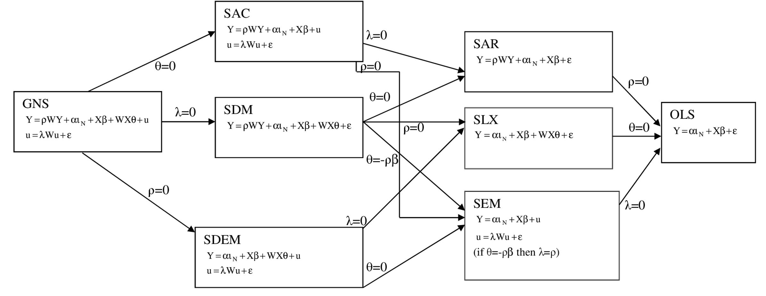
Spatial Configuration
Anselin & Vega (2013)

Slide 62
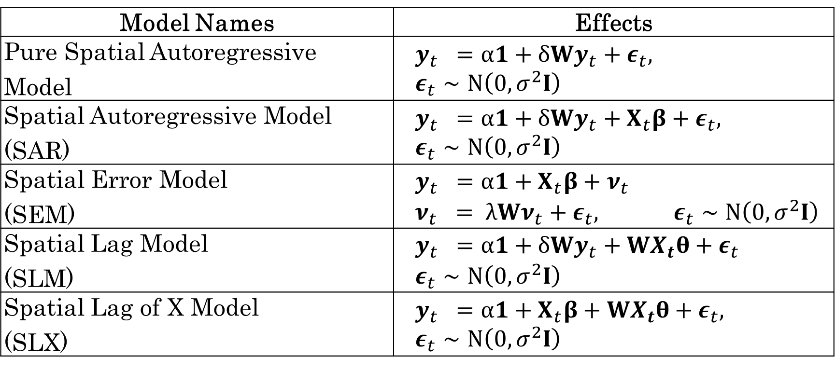
Spatial Configuration
Model Names | Effects
Pure Spatial Autoregressive Model | $$y_{t} =α1+δWy_{t}+ε_{t}, ε_{t}∼N\left(0, σ^{2}I\right)$$
Spatial Autoregressive Model (SAR) | $$y_{t} =α1+δWy_{t}+X_{t}β+ε_{t}, ε_{t}∼N\left(0, σ^{2}I\right)$$
Spatial Error Model (SEM) | $$y_{t} =α1+X_{t}β+ν_{t}$$ $$ν_{t} = λWν_{t}+ε_{t}, ε_{t}∼N\left(0, σ^{2}I\right)$$
Spatial Lag Model (SLM) | $$y_{t} =α1+δWy_{t}+WX_{t}θ+ε_{t}$$ $$ε_{t}∼N\left(0, σ^{2}I\right)$$
Spatial Lag of X Model (SLX) | $$y_{t} =α1+X_{t}β+WX_{t}θ+ε_{t}, ε_{t}∼N\left(0, σ^{2}I\right)$$

Slide 63
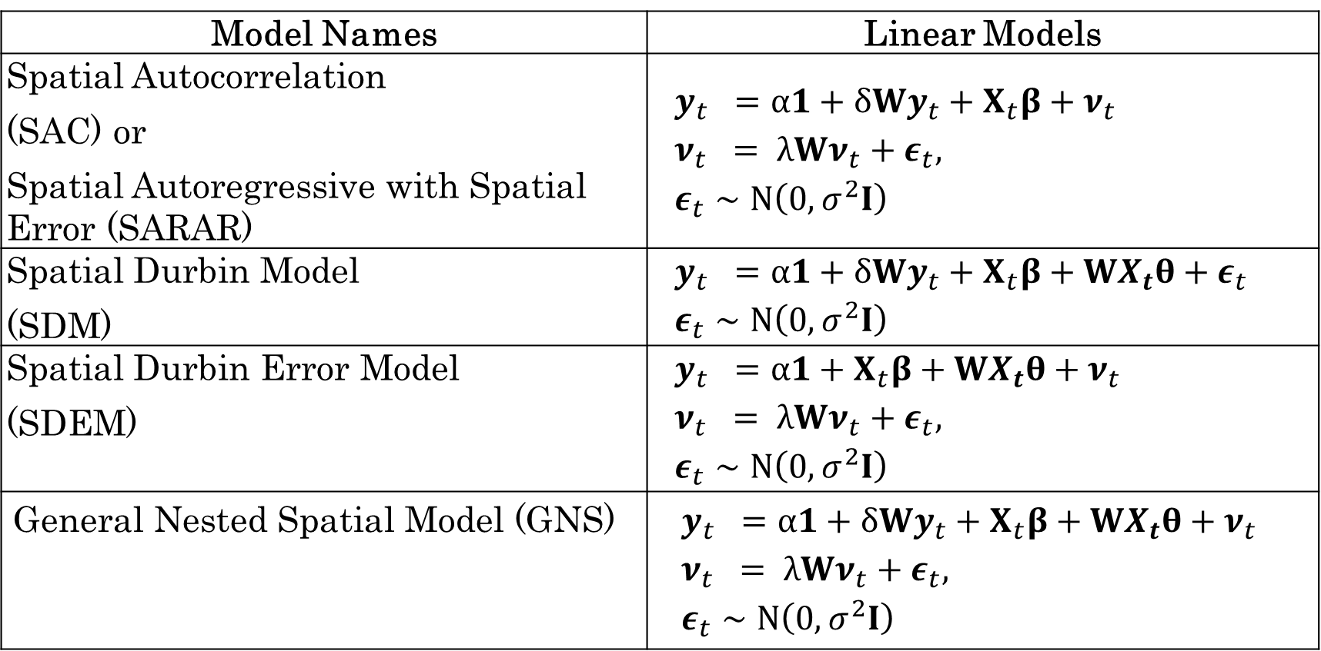
Spatial Configuration
Model Names | Linear Models
Spatial Autocorrelation (SAC) or Spatial Autoregressive with Spatial Error (SARAR) | $$y_{t} =α1+δWy_{t}+X_{t}β+ν_{t}$$ $$ν_{t} = λWν_{t}+ε_{t},$$ $$ε_{t}∼N\left(0, σ^{2}I\right)$$
Spatial Durbin Model (SDM) | $$y_{t} =α1+δWy_{t}+X_{t}β+WX_{t}θ+ε_{t}$$ $$ε_{t}∼N\left(0, σ^{2}I\right)$$
Spatial Durbin Error Model (SDEM) | $$y_{t} =α1+X_{t}β+WX_{t}θ+ν_{t}$$ $$ν_{t} = λWν_{t}+ε_{t},$$ $$ε_{t}∼N\left(0, σ^{2}I\right)$$
General Nested Spatial Model (GNS) | $$y_{t} =α1+δWy_{t}+X_{t}β+WX_{t}θ+ν_{t}$$ $$ν_{t} = λWν_{t}+ε_{t},$$ $$ε_{t}∼N\left(0, σ^{2}I\right)$$

Slide 64
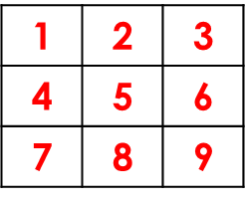
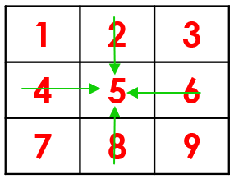
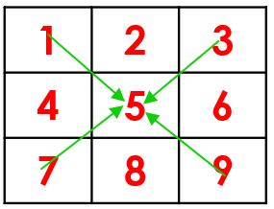
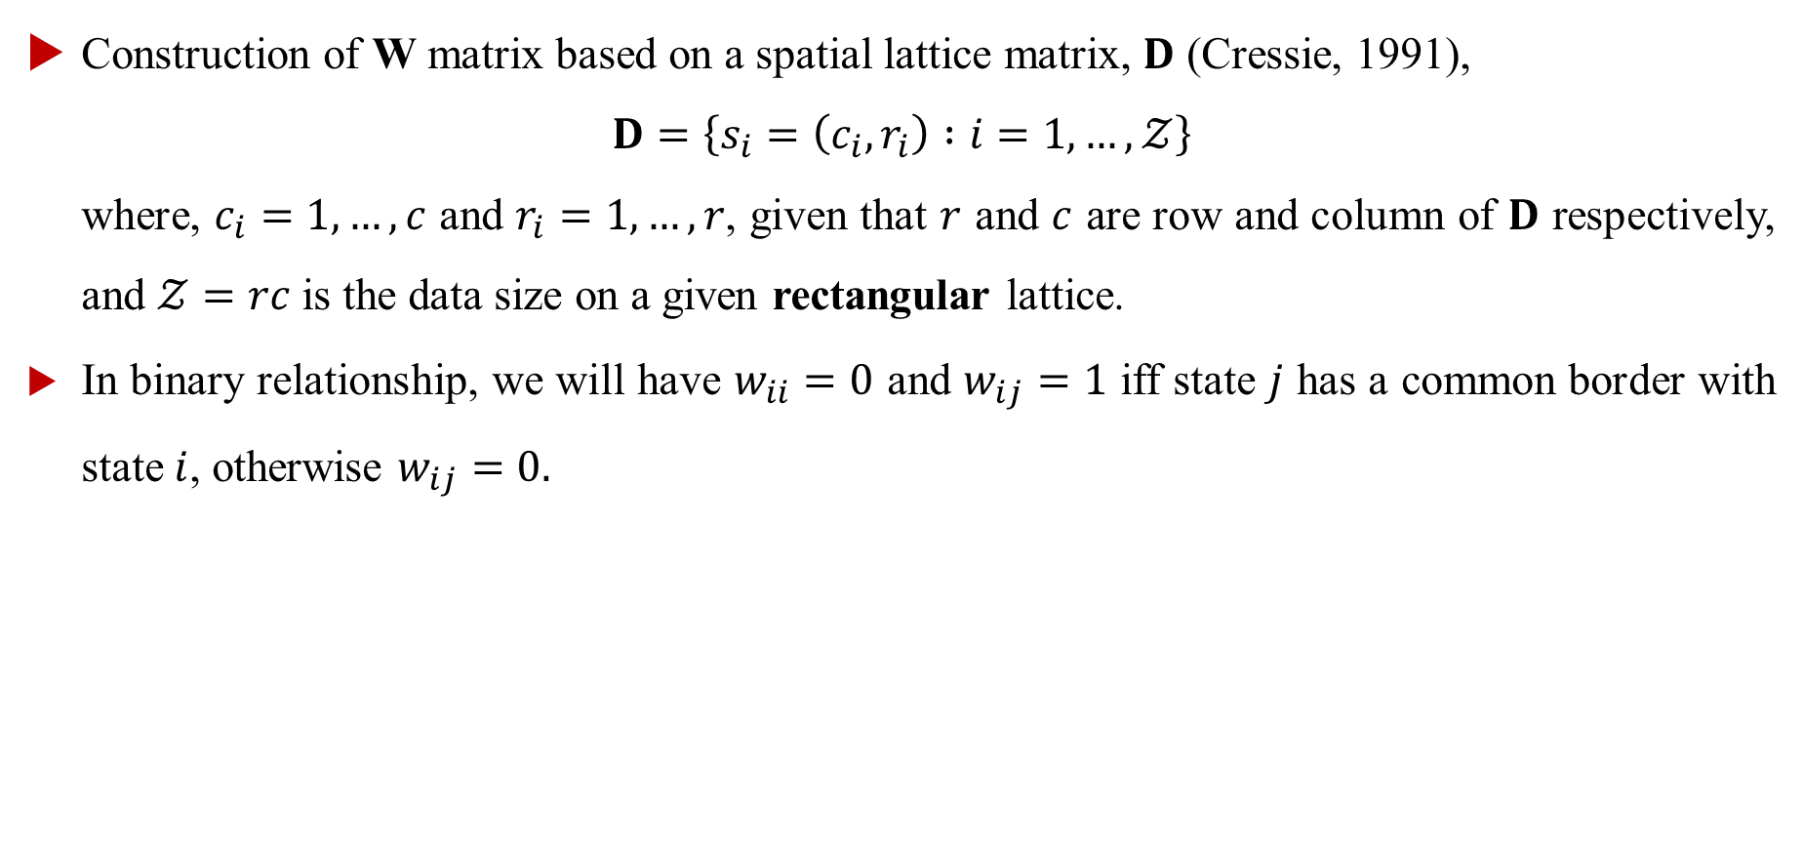
THE ROLE OF W MATRIX: Neighborhood System
Construction of W matrix based on a spatial lattice matrix, $D$ (Cressie, 1991),
$$D=\left\{s_{i}=\left(c_{i},r_{i}\right) :i=1,…, 𝒵\right\}$$
where, $c_{i}=1,…,c$ and $r_{i}=1,…,r$, given that $r$ and $c$ are row and column of $D$ respectively, and $𝒵=rc$ is the data size on a given rectangular lattice.
In binary relationship, we will have $w_{ii}=0$ and $w_{ij}=1$ iff state $j$ has a common border with state $i$, otherwise $w_{ij}=0.$
Artificial Grid-cell
Primary Neighborhood
Secondary Neighborhood

Slide 65

THE ROLE OF W MATRIX: Neighborhood System
Mathematical and statistical relationship:
Primary: $y_{5}=α+ρ_{p}\left(w_{25}y_{2}+w_{45}y_{4}+w_{65}y_{6}+w_{85}y_{8}\right)$
Secondary: $y_{5}=α+ρ_{s}\left(w_{15}y_{1}+w_{35}y_{3}+w_{75}y_{7}+w_{95}y_{9}\right)$
$w_{25}$ = weighted relationship between region 2 and 5
$w_{75}$ = weighted relationship between region 7 and 5
$$y_{i}=α+ρ\sum_{j≠i}{w_{ij}y_{j}}+ε_{i}, ε_{i} \sim N(0,σ^{2})$$
Artificial Grid-cell
Primary Neighborhood
Secondary Neighborhood

Slide 66

THE ROLE OF W MATRIX: Neighborhood System
$$y_{i}=α+ρ\sum_{j≠i}{w_{ij}y_{j}}+ε_{i}, ε_{i} \sim N\left(0,σ^{2}\right)$$
$i=1,…,N$. Rewrite in the matrix form as follows,
$$Y=α+ρWY+ε, ε\sim N\left(0,σ^{2}I\right)$$
where,
$Y$ dependent variable with $N×1$ vector.
$W$ is a spatial neighbor matrix with $N×N$ dimension.
$W$ stores neighborhood information.

Slide 67


THE ROLE OF W MATRIX: Neighborhood System
$$W=\left[\begin{matrix}w_{1,1} & … & w_{1,N} \\ ⋮ & & ⋮ \\ w_{N,1} & … & w_{N,N}\end{matrix}\right]$$
$w_{i,j}≠0$ if there is neighboring relationship, otherwise $w_{i,j}=0$. $w_{i,i}=0$

Slide 68

THE ROLE OF W MATRIX: Binary Relationship
Based on common borders relationship. Meaning:
$$w_{i,j}=\left\{\begin{aligned}1, if region i and region j shares administrative border \\ \\ 0.if region i and region j do not shares administrative border\end{aligned}\right.$$

Slide 69


THE ROLE OF W MATRIX: Binary Relationship
Based on $region i and region j shares administrative border$
Problematic for islands and archipelago regions.

Slide 70

THE ROLE OF W MATRIX: Binary Relationship

Slide 71


SPATIAL NEIGHBOR W MATRIX: Sumatra Island
Spatial W matrix of Provinces in Sumatra Island
$$W_{10×10}$$
Cell | 1 | 2 | 3 | 4 | 5 | 6 | 7 | 8 | 9 | 10
1 | 0 | 1 | 0 | 0 | 0 | 0 | 0 | 0 | 0 | 0
2 | 1 | 0 | 1 | 1 | 0 | 0 | 0 | 0 | 0 | 0
3 | 0 | 1 | 0 | 1 | 1 | 0 | 1 | 0 | 0 | 0
4 | 0 | 1 | 1 | 0 | 1 | 0 | 0 | 0 | 0 | 0
5 | 0 | 0 | 1 | 1 | 0 | 1 | 1 | 0 | 0 | 0
6 | 0 | 0 | 0 | 0 | 1 | 0 | 1 | 1 | 0 | 0
7 | 0 | 0 | 1 | 0 | 1 | 1 | 0 | 1 | 0 | 0
8 | 0 | 0 | 0 | 0 | 0 | 1 | 1 | 0 | 0 | 0
9 | 0 | 0 | 0 | 0 | 0 | 0 | 0 | 0 | 0 | 0
10 | 0 | 0 | 0 | 0 | 0 | 0 | 0 | 0 | 0 | 0

Slide 72

THE ROLE OF W MATRIX: Distance
Weights may be also defined as a function of the distance between region $i$ and $j$, $d_{ij}$.
$d_{ij}$ is usually computed as the distance between their centroids (or other important unit).
Let $x_{i}$ an $x_{j}$ be the longitude and $y_{i}$ and $y_{j}$the latitude coordinates for region $i$ and $j$.

Slide 73

THE ROLE OF W MATRIX: Distance

Slide 74

THE ROLE OF W MATRIX: Distance

Slide 75

THE ROLE OF W MATRIX: Distance

Slide 76

THE ROLE OF W MATRIX: Distance
By definition of spatial relationship, the closer distance has higher spatial interlinkage. Thus,
Inverse distance
$$w_{i,j}=\left\{\begin{aligned}1/d_{ij}, if i≠j \\ \\ 0. if i=j\end{aligned}\right.$$
Negative exponential model,
$$w_{i,j}=\exp\left(\frac{d_{ij}}{α}\right)$$

Slide 77

THE ROLE OF W MATRIX: Distance
Threshold Distance (Distance Band Weights):
The threshold distance specifies that an region $i$ is neighbor of region $j$ if the distance between them is less than a certain distance.
$$w_{i,j}=\left\{\begin{aligned}1, if 0≤d_{ij}≤d_{max} \\ \\ 0,if{ d}_{ij}>d_{max} \end{aligned}\right.$$

Slide 78

THE ROLE OF W MATRIX: Row Standardization
$W$ are used to compute weighted averages in which more weight is placed on nearby observations than on distant observations.
The elements of a row-standardized weights matrix equal.
$$w_{i,j}^{s}=\frac{w_{i,j}}{\sum_{j}{w_{i,j}}}, {0≤w}_{i,j}^{s}≤1$$
The row-standardized weights matrix also ensures that the spatial
parameter in many spatial stochastic processes are comparable between
models.

Slide 79


THE ROLE OF W MATRIX: Row Standardization

Slide 80
THE ROLE OF W MATRIX: Row Standardization
Row-standardized spatial W matrix of Provinces in Sumatra Island
$$W_{10×10}$$
Cell | 1 | 2 | 3 | 4 | 5 | 6 | 7 | 8 | 9 | 10
1 | 0 | 1 | 0 | 0 | 0 | 0 | 0 | 0 | 0 | 0
2 | 0.3 | 0 | 0.3 | 0.3 | 0 | 0 | 0 | 0 | 0 | 0
3 | 0 | 0.25 | 0 | 0.25 | 0.25 | 0 | 0.25 | 0 | 0 | 0
4 | 0 | 0.3 | 0 | 0.3 | 0.3 | 0 | 0 | 0 | 0 | 0
5 | 0 | 0 | 0.25 | 0.25 | 0 | 0.25 | 0.25 | 0 | 0 | 0
6 | 0 | 0 | 0 | 0 | 0.3 | 0 | 0.3 | 0.3 | 0 | 0
7 | 0 | 0 | 0.25 | 0 | 0.25 | 0.25 | 0 | 0.25 | 0 | 0
8 | 0 | 0 | 0 | 0 | 0 | 0.5 | 0.5 | 0 | 0 | 0
9 | 0 | 0 | 0 | 0 | 0 | 0 | 0 | 0 | 0 | 0
10 | 0 | 0 | 0 | 0 | 0 | 0 | 0 | 0 | 0 | 0

Slide 81


SPATIAL AUTOREGRESSIVE MODEL: Reduced Form
Pure Spatial autoregressive (PSAR) model is expressed as follows,
$$y=ρWy+ε, ε_{i}∼N\left(0, σ^{2}\right)$$
Reduced form
$$y=ρWy+ε$$
$$y−ρWy=ε$$
$$\left(I_{N}−ρW\right)y=ε$$
$$y={\left(I_{N}−ρW\right)}^{−1}ε$$

Slide 82


SPATIAL AUTOREGRESSIVE MODEL: Reduced Form
Reduced form for PSAR model is expressed as follows,
Condition: $B$ is invertible matrix, $det\left(B\right)≠0$
Implication:
$$Wy=W{\left(I_{N}−ρW\right)}^{−1}ε$$
$$y={\left(I_{N}−ρW\right)}^{−1}ε$$
$$y=B^{−1}ε$$

Slide 83

Analisis Wilayah DI Yogyakarta: Pop Distribution
DI Yogyakarta Population Distribution 2022
Spatial Analysis: Pure Spatial Autoregressive Model
$$y_{t} =α1+δWy_{t}+ε_{t}, ε_{t}∼N\left(0, σ^{2}I\right)$$
LandScan Gridded Data
Spatial Dimension: 30 x 30 arc second (~ 1 km)
Source: Oak Ridge National Laboratory

Slide 84


Analisis Wilayah DI Yogyakarta: Pop Distribution
DI Yogyakarta Population Distribution 2022
LandScan Gridded Data
Spatial Dimension: 30 x 30 arc second (~ 1 km)
Source: Oak Ridge National Laboratory

Slide 85

Analisis Wilayah DI Yogyakarta: Pop Distribution
DI Yogyakarta Population Distribution 2022
Spatial Analysis: Pure Spatial Error Model
$$y_{t} =α1+ν_{t}, \\ ν_{t} = λWν_{t}+ε_{t},$$
LandScan Gridded Data
Spatial Dimension: 30 x 30 arc second (~ 1 km)
Source: Oak Ridge National Laboratory

Slide 86


Analisis Wilayah DI Yogyakarta: Pop Distribution
DI Yogyakarta Population Distribution 2022
LandScan Gridded Data
Spatial Dimension: 30 x 30 arc second (~ 1 km)
Source: Oak Ridge National Laboratory

Slide 87

Analisis Wilayah DI Yogyakarta: Pop Distribution
DI Yogyakarta Population Distribution 2022
Spatial Analysis: Spatial Autoregressive Model
$$y_{t} =α1+δWy_{t}+Xβ+ε_{t}, ε_{t}∼N\left(0, σ^{2}I\right)$$
LandScan Gridded Data
Spatial Dimension: 30 x 30 arc second (~ 1 km)
Source: Oak Ridge National Laboratory

Slide 88


Analisis Wilayah DI Yogyakarta: Pop Distribution
DI Yogyakarta Population Distribution 2022
LandScan Gridded Data
Spatial Dimension: 30 x 30 arc second (~ 1 km)
Source: Oak Ridge National Laboratory

Slide 89

THANK YOU

